Slide 1
REQUIREMENTS ENGINEERING
JIMMA UNIVERSITY
JIMMA INSTITUTE OF TECHNOLOGY
FACULTY OF COMPUTING AND INFORMATICS
CHAPTER FOUR
REQUIREMENTS SPECIFICATION & DOCUMENTATION
Notes:
IT Project Management - ITec 2063

Slide 2
Topics we will cover
Requirements Specification
Requirements Document
Methods for Software requirements Specification
  Free documentation in unrestricted natural language
  Disciplined documentation in structured natural language

Slide 3
Requirements Specifications
A software requirements specification is a collection of the set of all requirements that are to be imposed on the design and verification of the product/software.
During software requirements specification :
  Define your product's purpose and scope.
  Describe what you're building.
  Details the requirements.
  Supporting information.
  Resulting product: Requirements Document

Slide 4
Requirements Document
Requirements document is a reference document.
Once the a requirement document is approved by the customer,
  any subsequent controversies are settled by referring the document.
Purpose of SRS:
  Interface (communication) between the Customer, requirement engineers Analyst, designers, system developers, testers and maintainers.
  Agreement between Purchaser and Supplier
  Support verification and validation of requirements.
  Support system testing activities
  Support project management activities
  Controlling the evolution of overall system

Slide 5
Characteristics of a Software Requirements Specification
A good SRS is:
  Unambiguous,
  Complete,
  Verifiable,
  Consistent,
  Modifiable, and
  Traceable

Slide 6
Unambiguous
Every requirement has only one interpretation.
Each characteristics of the final product is described using a single unique term.
A glossary should be used when a term used in a particular context could have multiple meanings.

Slide 7
Complete
A complete SRS must possess the following qualities:
    Inclusion of all significant requirements,
    Definitions of the responses of the software to all realizable classes of input,
    Conformity to any standard that applies to it.
    Full labeling and referencing of all tables and diagrams and definitions of all terms.

Slide 8
Verifiable
Every requirement must be verifiable.
There must exist some finite cost- effective process with which a person or machine can check that the software meets the requirement.

Slide 9
Consistent
No set of individual requirements described in the SRS can be in conflict.
  Types of likely conflicts:
    Two or more requirements describe the same real world object in different terms.
    The specified characteristics of real world objects might conflict.
    There may be a logical or temporal conflict between two specified actions.

Slide 10
Modifiable
The structure and style of the SRS are such that any necessary changes to the requirements can be made easily, completely and consistently.
Requirements:
  A coherent and easy-to-use organization(including a table of contents, index and cross-referencing),
  Not be redundant-this can lead to errors.

Slide 11
Traceable
The origin of each requirement must be clear.
The SRS should facilitate the referencing of each requirement in future development or enhancement documentation.
Types:
  Backward traceability: each requirement must explicitly reference its source in previous documents.
  Forward traceability: each requirement must have an unique name or reference number.

Slide 12
Problems without a SRS document
The important problems that an organization would face if it does not develop a SRS document are as follows:
  Without developing the SRS document, the system would not be implemented according to customer needs.
  Software developers would not know whether what they are developing is what exactly required by the customer.
  Without SRS document, it will be very much difficult for the maintenance engineers to understand the functionality of the system.
  It will be very much difficult for user document writers to write the users’ manuals properly without understanding the SRS document.

Slide 13
Methods for Software requirements Specification
  The formality and format of a specification varies with the size and the complexity of the software to be built.
  For large systems, disciplined documentation in structured natural language may be the best methods.
  For small systems or product, free documentation in unrestricted natural language

Slide 14
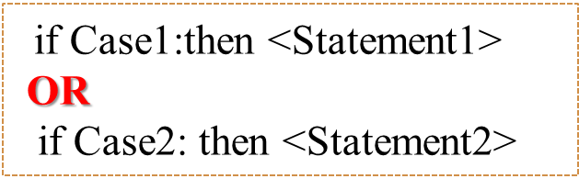
Free documentation in unrestricted natural language
Unconstrained prose writing in natural language.
  Unlimited expressiveness, communicability, no training needed
  Prone to many of the spec errors & flaws
Cons: Frequent confusions among logical connectives in natural language and order of the contents.
Example: case analysis:
if Case1:then <Statement1>
AND
if Case2: then <Statement2>

Slide 15
Use Disciplined documentation in structured in natural languages
Use standardized statement templates.
Title of standard:
  “IEEE Recommended Practice for Software Requirements Specification”
    Describes the content and qualities of a good SRS
    Presents several sample SRS outlines

Slide 16
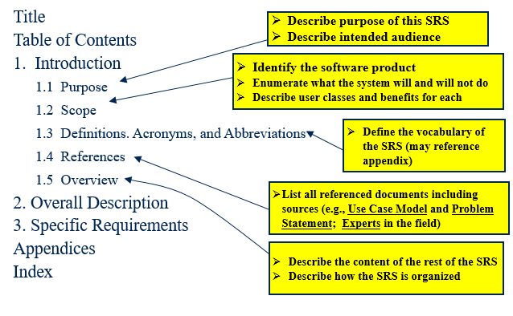
IEEE 830-1998 Standard – Structure of the SRS

Slide 17
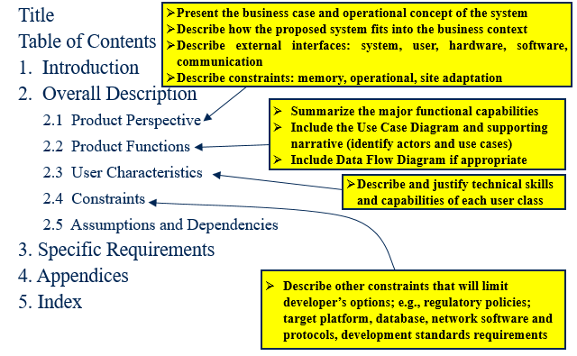
IEEE 830-1998 Standard – Structure of the SRS

Slide 18
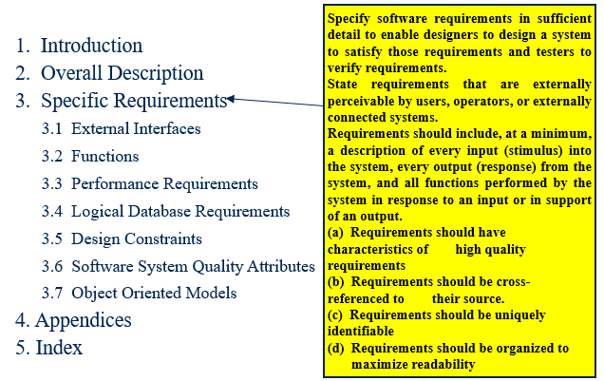
IEEE 830-1998 Standard – Structure of the SRS

Slide 19
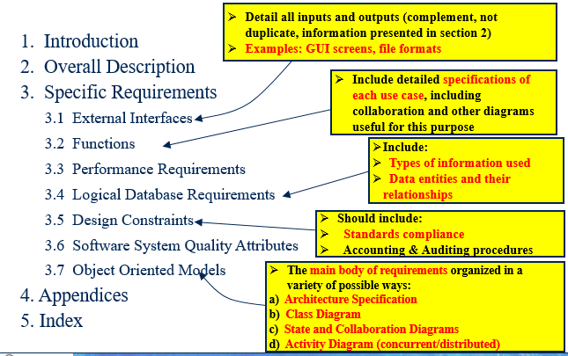
IEEE 830-1998 Standard – Structure of the SRS

Slide 20
Key Points
Requirements Specification
Requirements Document
Methods for Software requirements Specification

Slide 21

Any Question?

